Slide 1
Photography
Unit 4 – Composition & Principles of Design

Slide 2
Unit 4 – Composition & Design Principles
Section 1 – Composition

Slide 3
The big idea
Learn about the elements of art
Learn about the principles of design
How to use the elements and principles to make photographs

Slide 4
Google Classroom Code
Photography
rhxkpt
Photography
7mdo2ur

Slide 5
Elements and Principles
Elements
Line
Shape and Form
Color
Primary
Secondary
Value
Space
Texture
Principles
Pattern
Balance
Rules of Thirds
Unity and Variety
Movement and Rhythm
Emphasis
Proportion

Slide 6
Elements LINE
The most fundamental art element
Can serve as pathways to draw attention to a particular point
Create boundaries
Separate and/or differentiate

Slide 7


Slide 8
Elements Shape and Form
Shapes can be geometric or organic
Circles, ovals, triangles, rectangles
Wheels, road signs, windows are common examples
Organic examples could be clouds, puddles, footprints

Slide 9


Slide 10
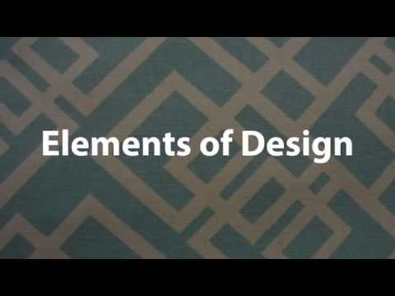
Elements of Art (Video)

